Slide 1
LEAVE MANAGEMENT SYSTEM
PROJECT DONE BY;
1.RA1911003010380(LOKESH KUMAR.S)
2.RA1911003010402(vijay.T)
3.RA1911003010399(HRITIK)

Slide 2
PROBLEM STATEMENT
In the existing system, leaves are maintained using the attendance register for staff. The staff needs to submit their leaves manually to their respective authorities. This increases the paperwork & maintaining the records becomes tedious. Maintaining notices in the records also increases the paperwork. The main objective of the proposed system is to reduce the paperwork and help in easier record maintenance by having a particular centralized Database System, where Leaves and Notices are maintained. The proposed system modernizes and automates the existing system. It decreases the paperwork and enables easier record maintenance. It also reduces chances of Data loss. This module intelligently adapts to HR policy of the management & allows easy leave handling for better scheduling of workload. This system will provide a connection between the user (staff) and the database hence enabling quick retrieval of the information without any intervention from the human resource manager. In this system employees can apply for leave online he/she can see his/her balance leave.

Slide 3
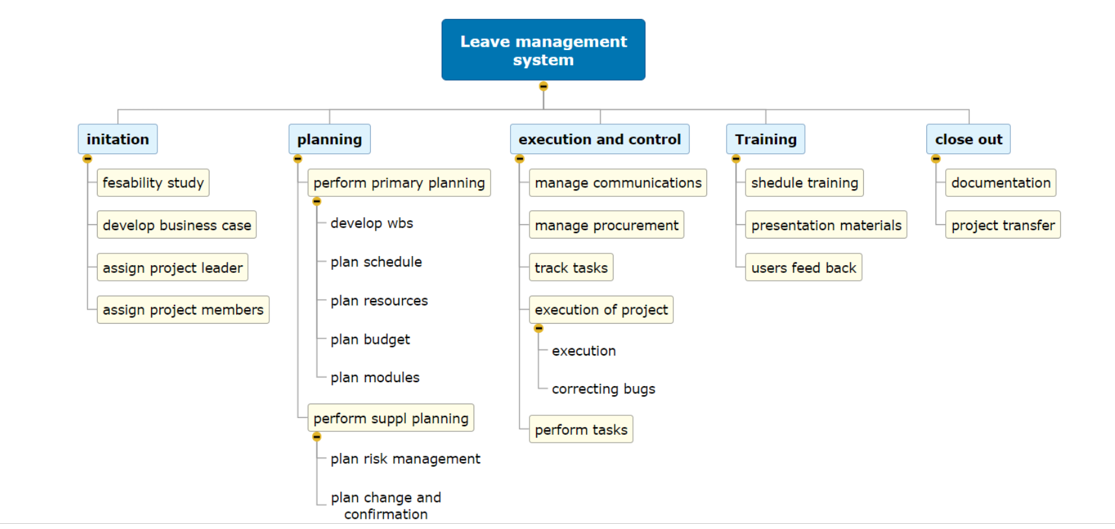
WORK PLANNING

Slide 4
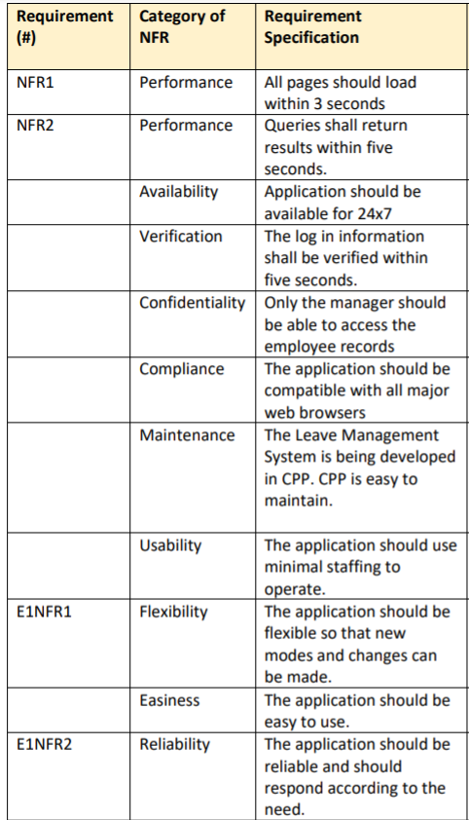
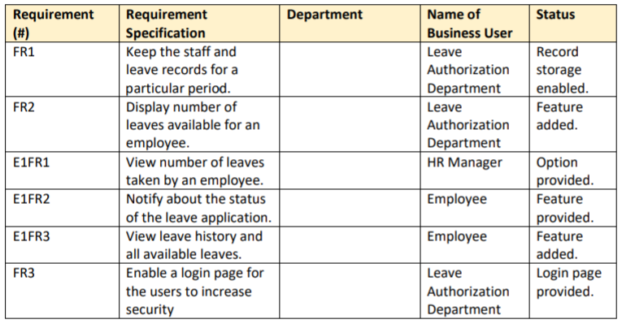
REQUIREMENTS
NON-FUNCTIONAL
FUNCTIONAL

Slide 5
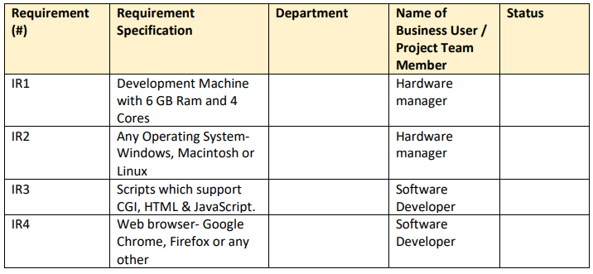
STRUCTURAL REQUIREMENTS

Slide 6
SOFTWARE STRUCTURAL DESIGN
UMLS

Slide 7
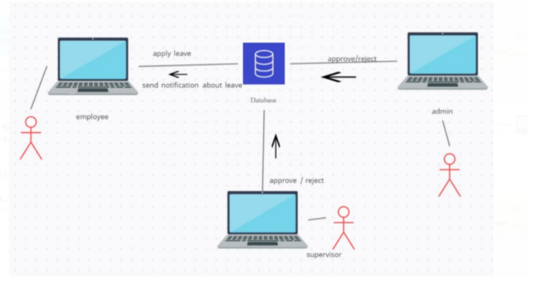
ARCHITECTURAL DIAGRAM

Slide 8
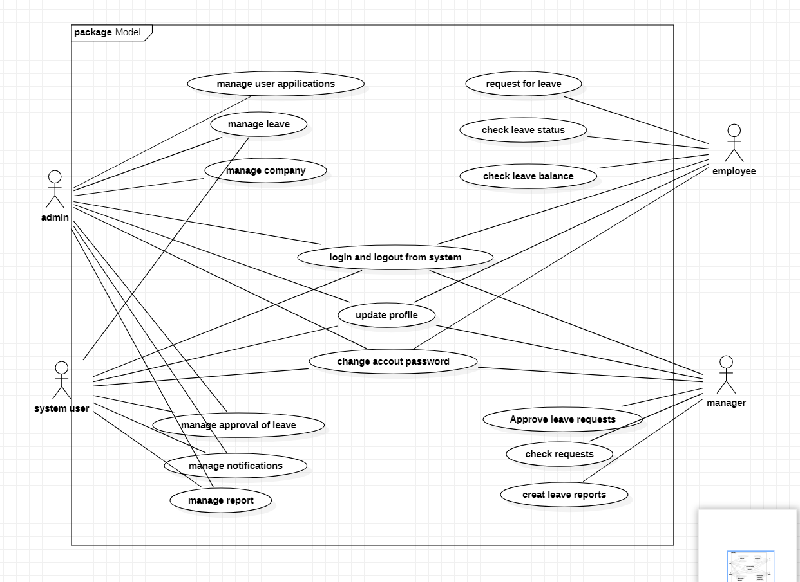
USE CASE DIAGRAM

Slide 9
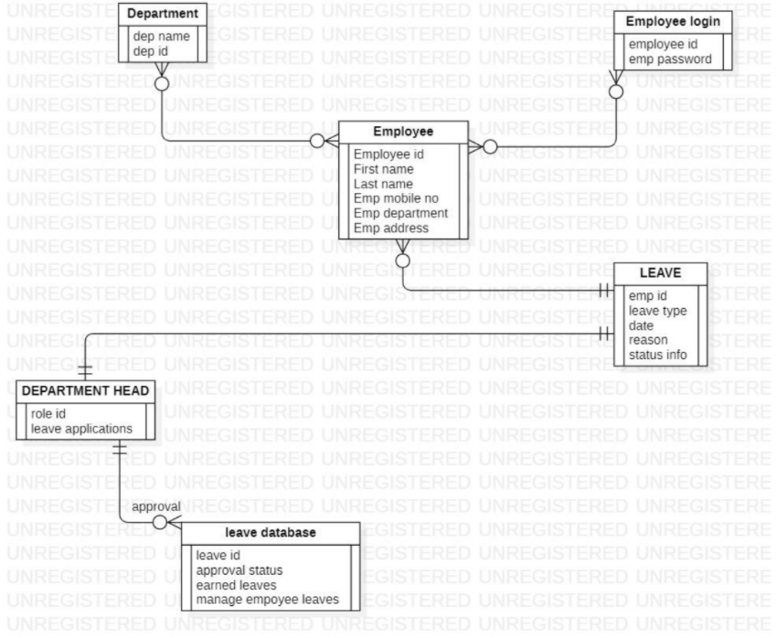
ER-DIAGRAM

Slide 10
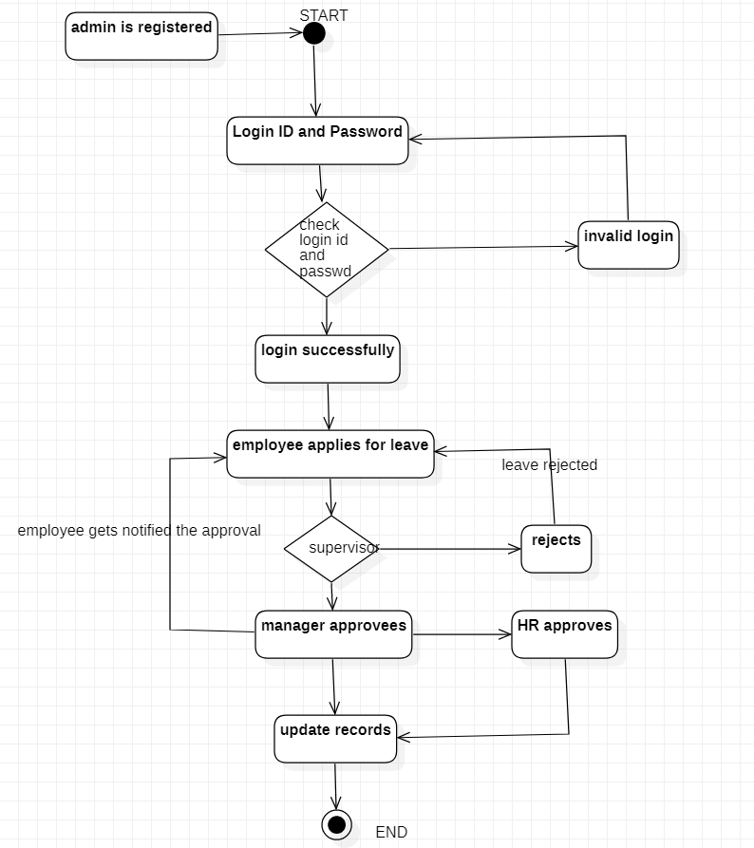
STATE CHART DIAGRAM

Slide 11
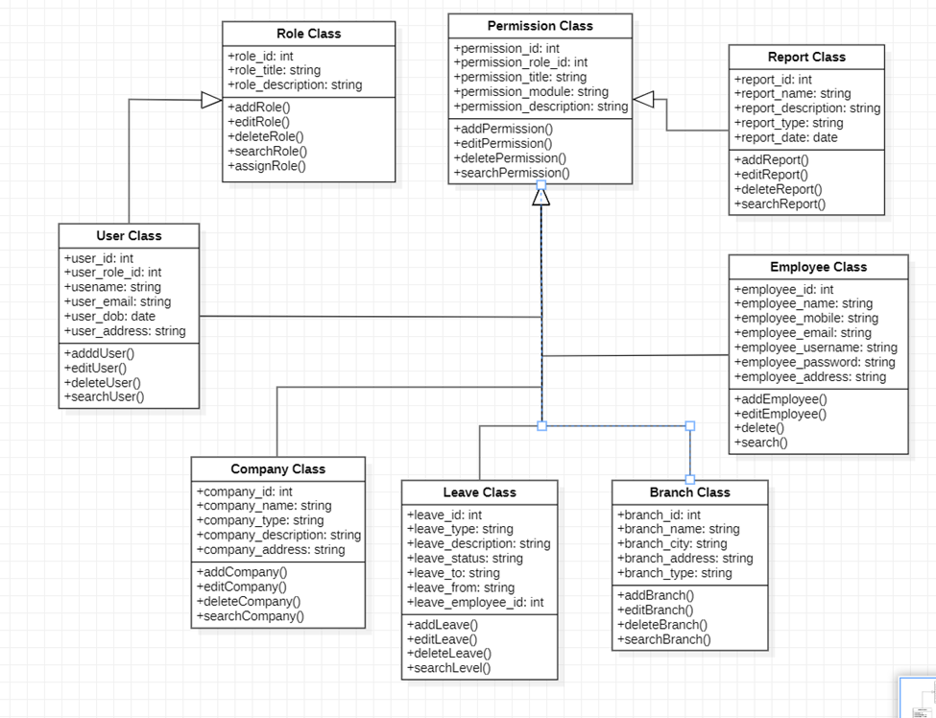
CLASS DIAGRAM

Slide 12
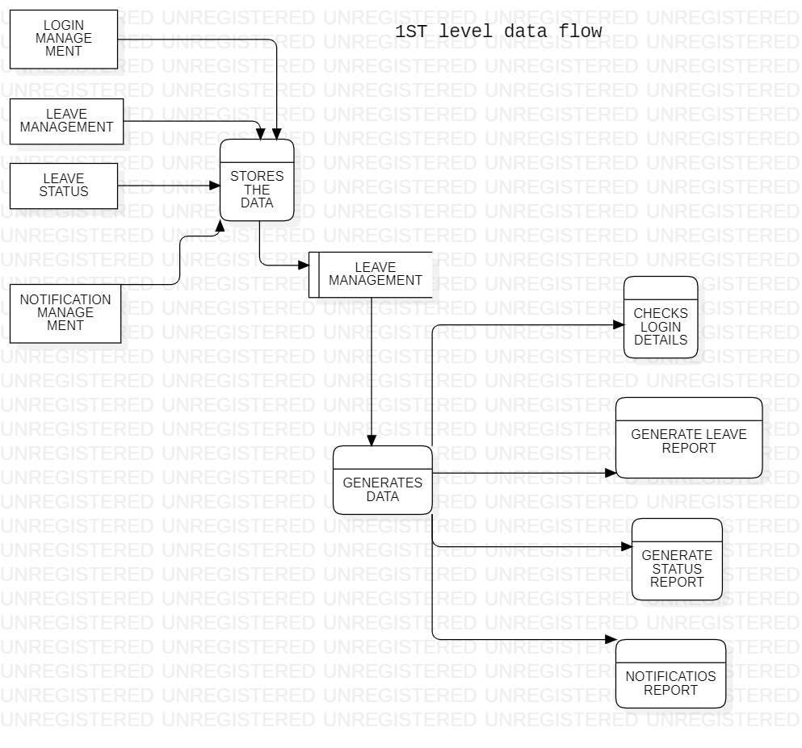
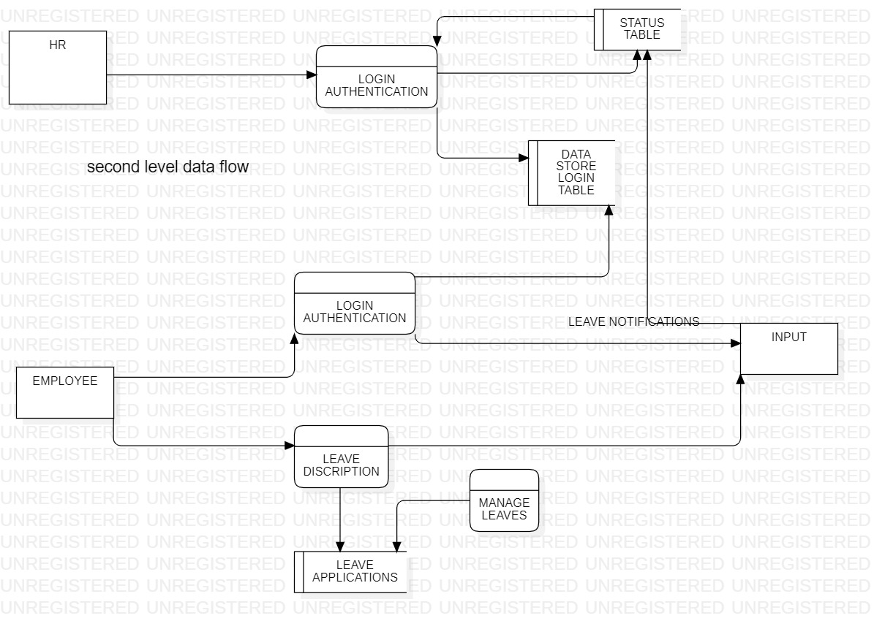
DATA FLOW DIAGRAM

Slide 13
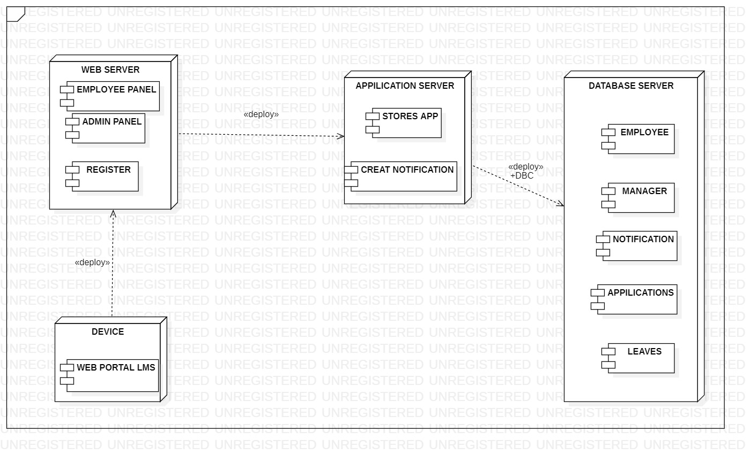
DEPLOYMENT DIAGRAM

Slide 14
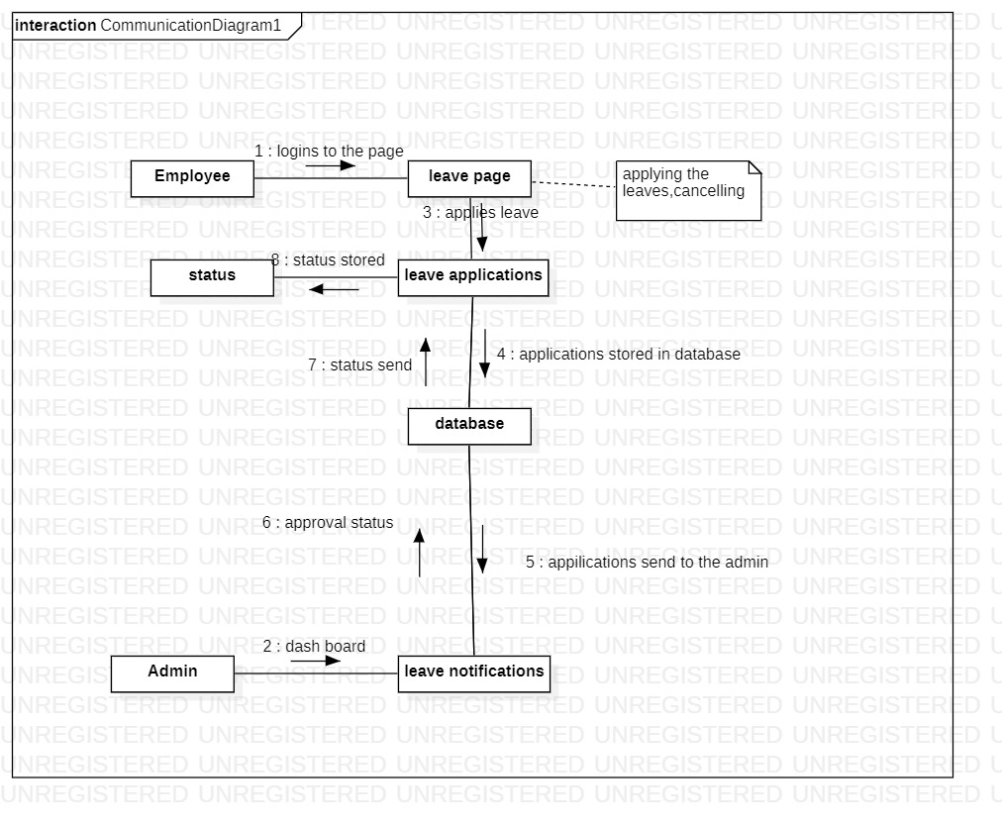
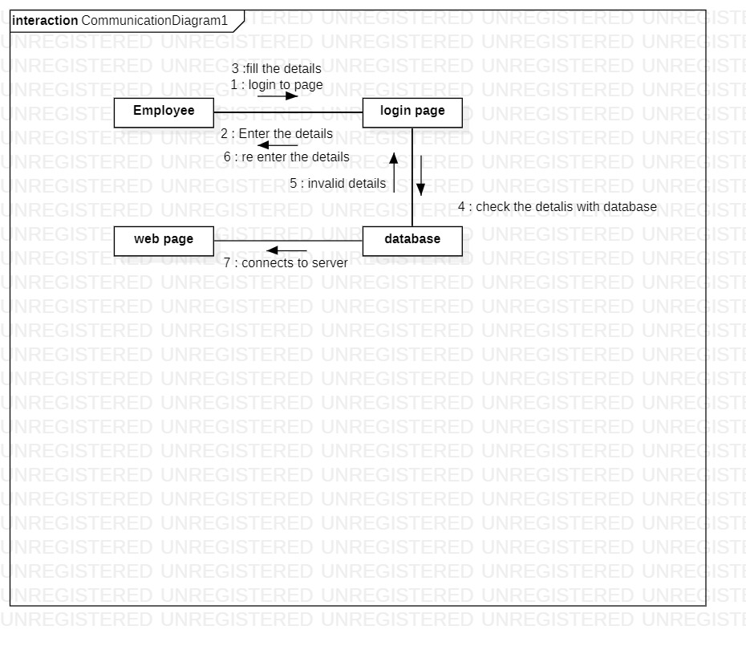
COMMUNICATION DIAGRAM

Slide 15
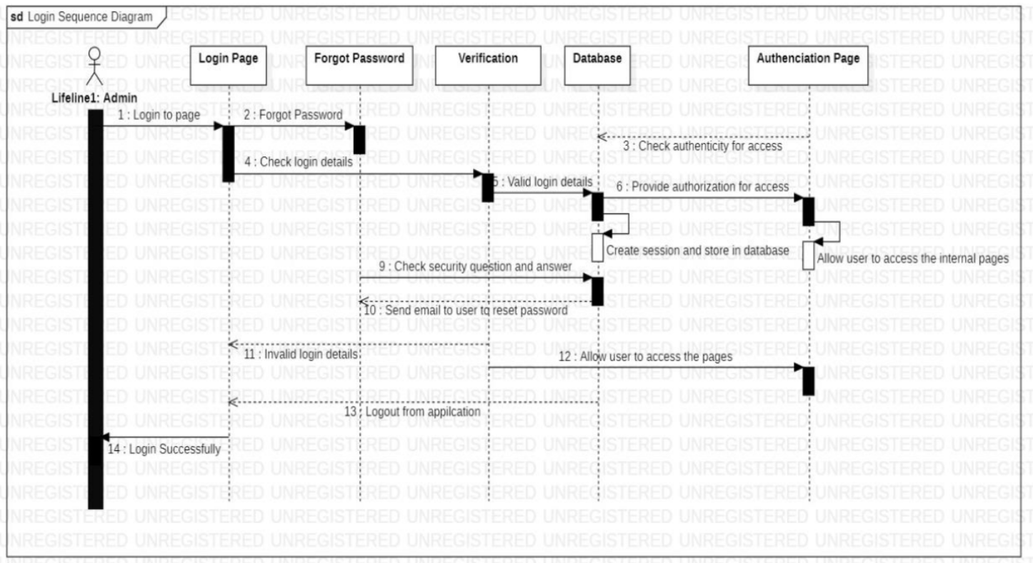
SEQUENCE DIAGRAM

Slide 16
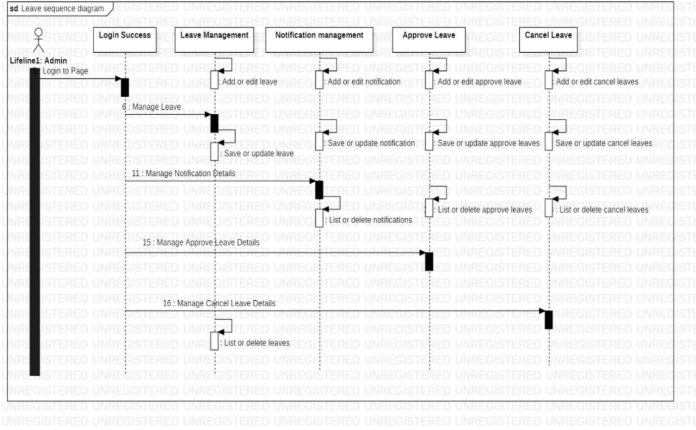

Slide 17
LMS
demo

Slide 18
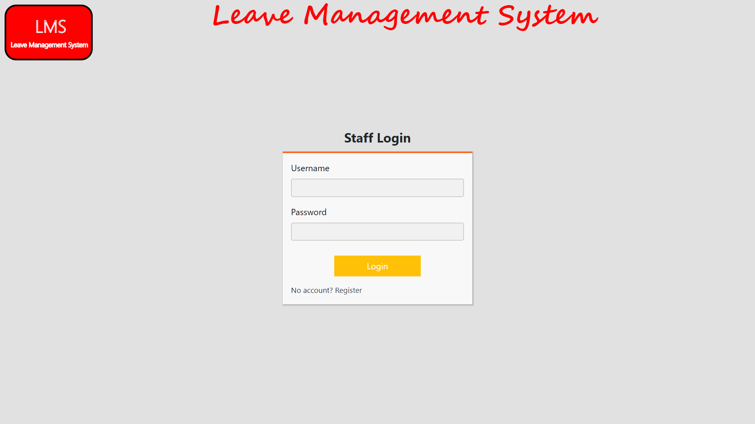
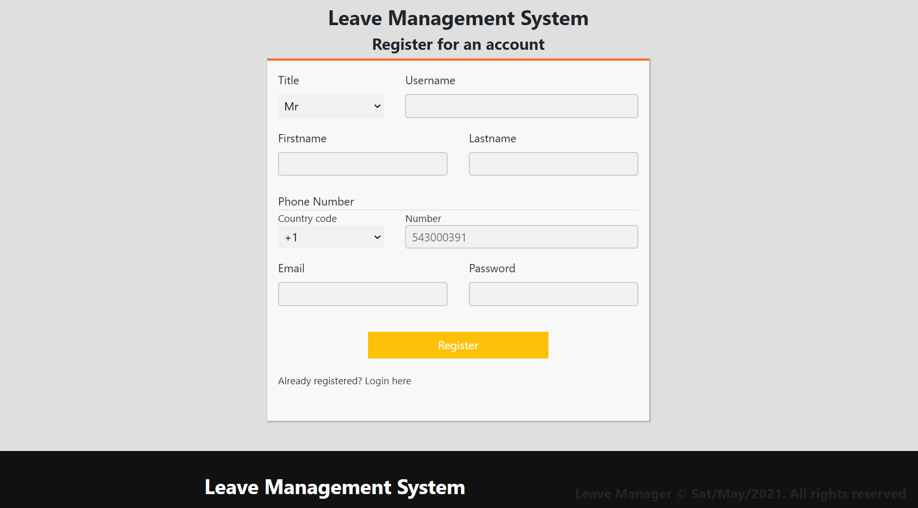
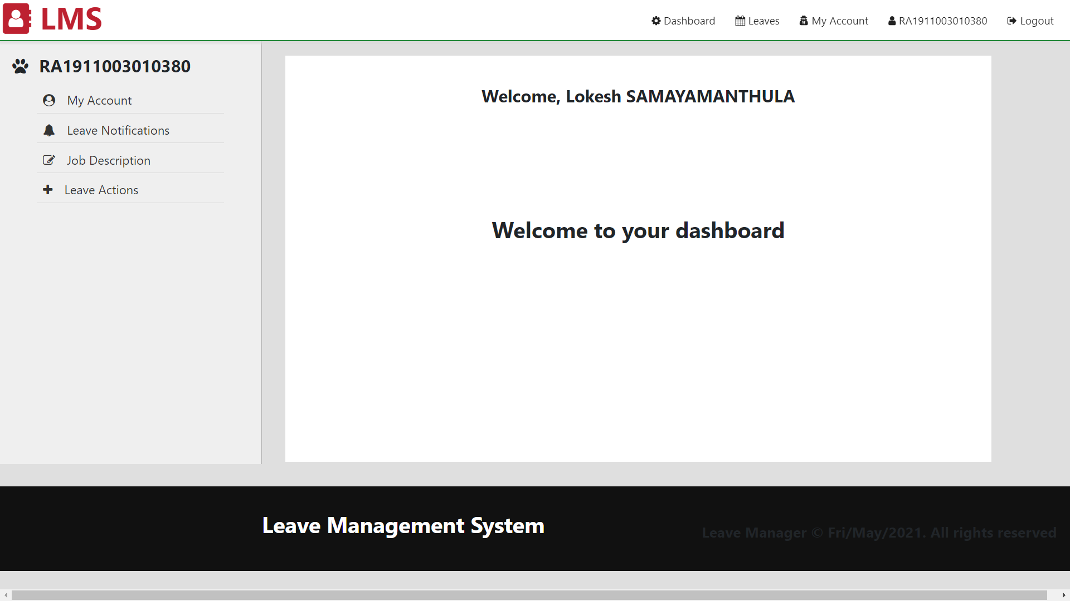
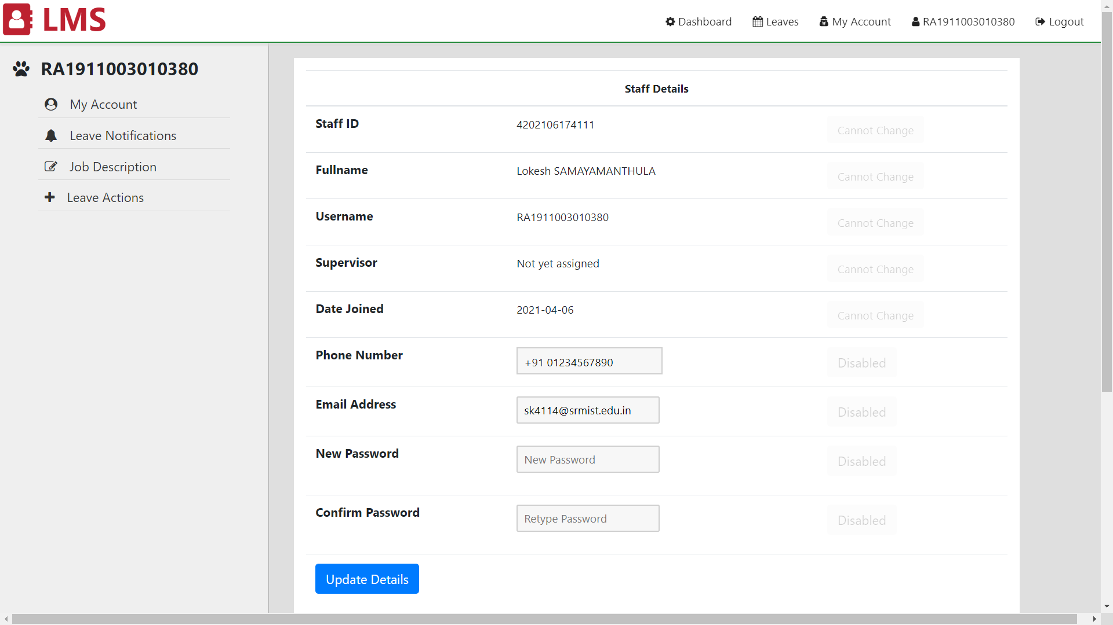

Slide 19
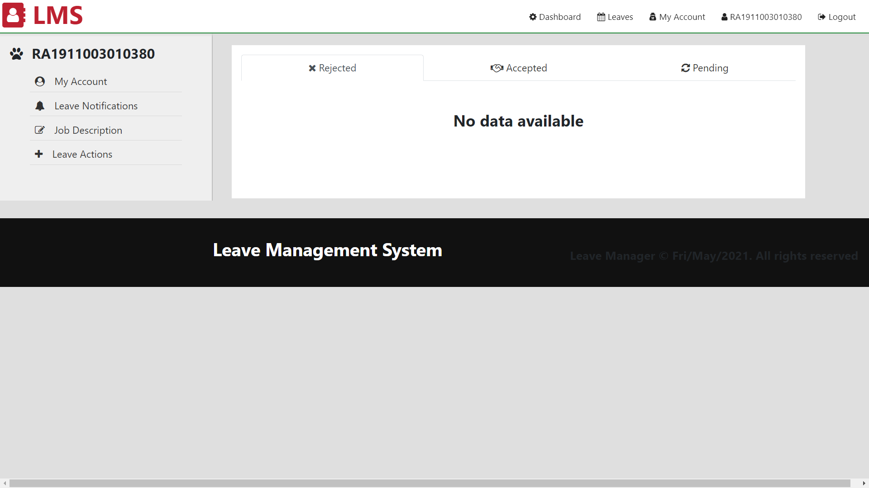
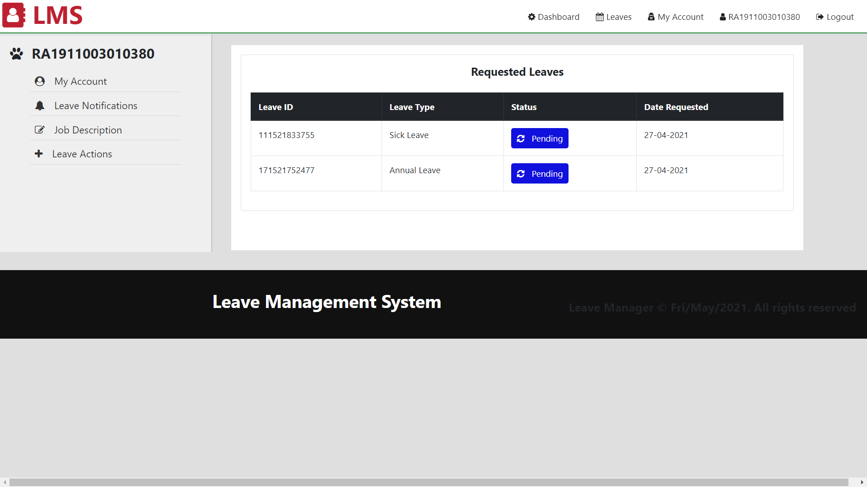
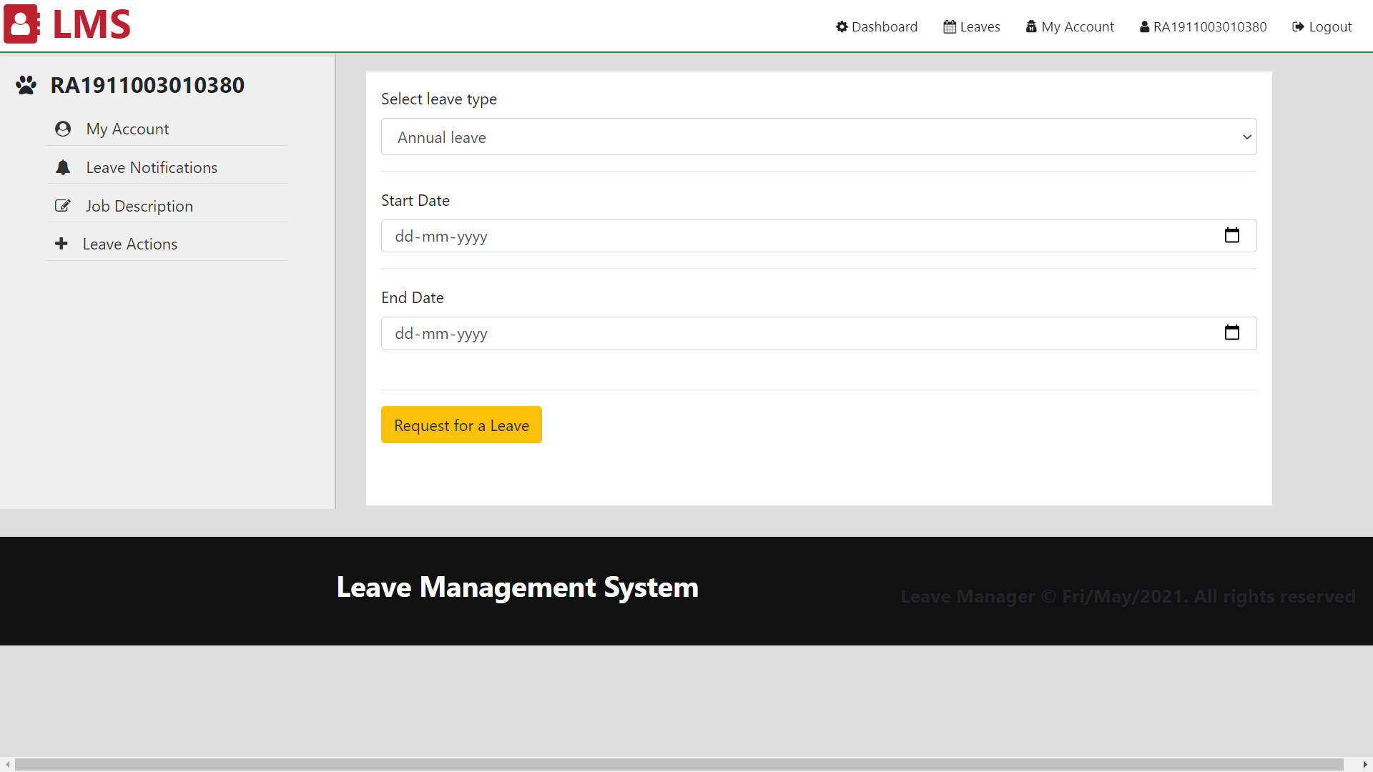
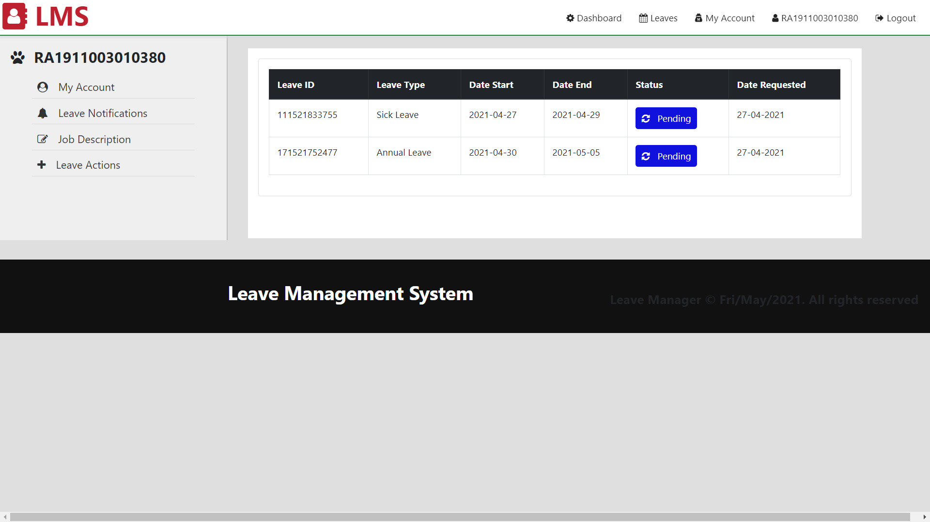

Slide 20
TESTING
MANUAL TESTING
TEST CASES

Slide 21
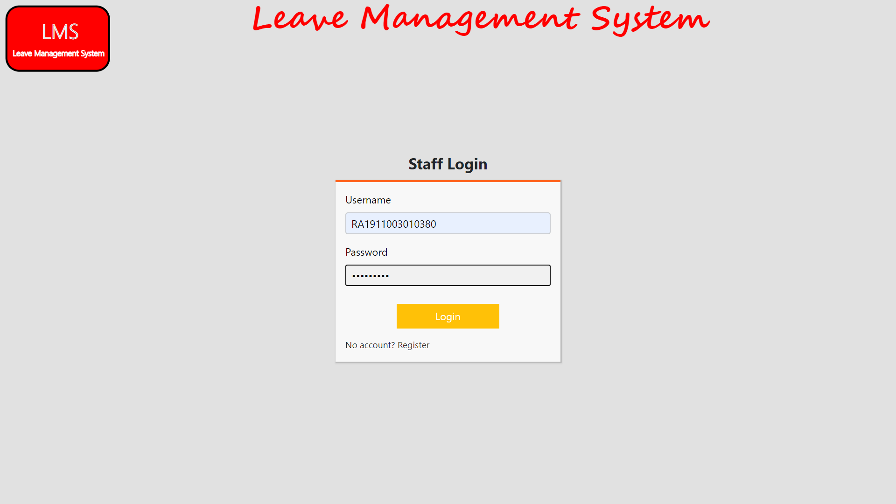
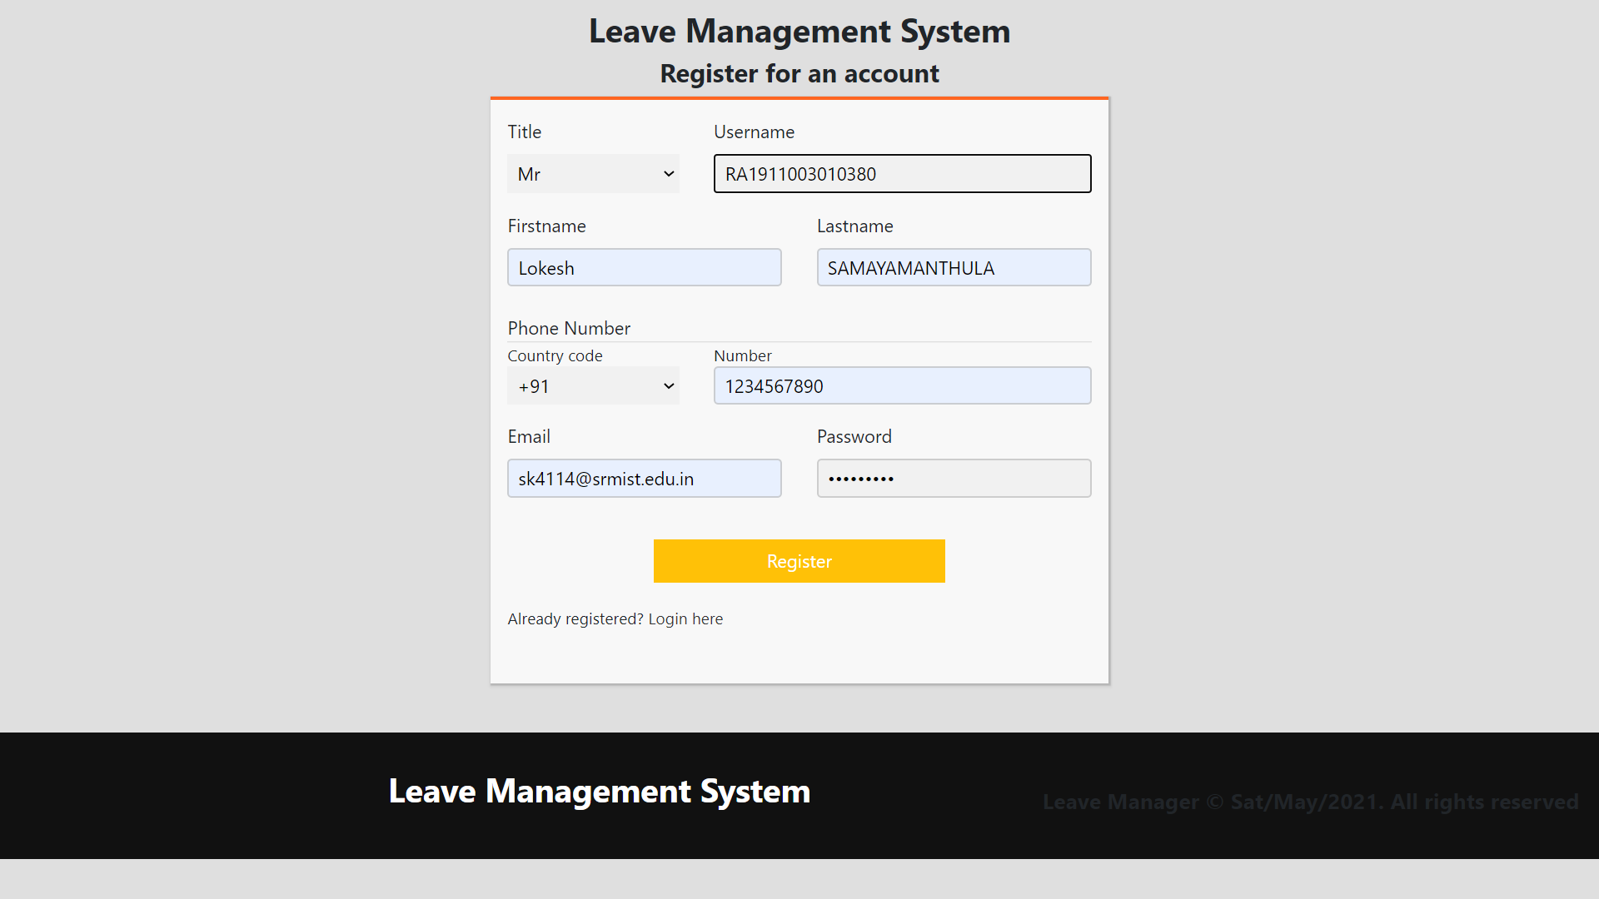

Check whether the data is entering in the text boxes
Check weather the user can login to the webpage

Slide 22
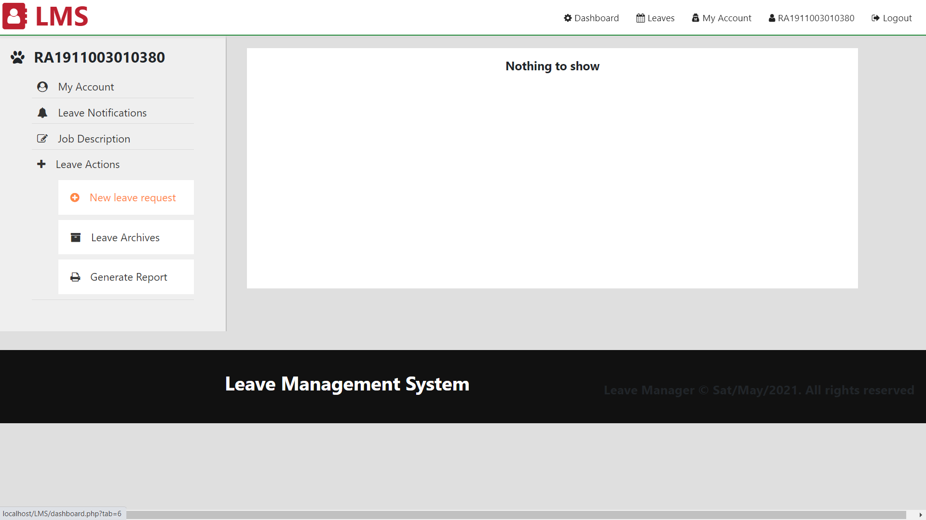
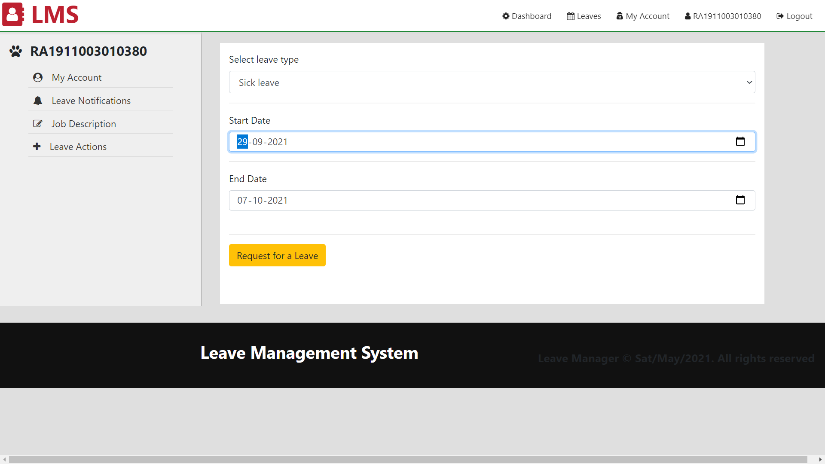
Check if we can request the leave
Check if we can apply for a leave

Slide 23
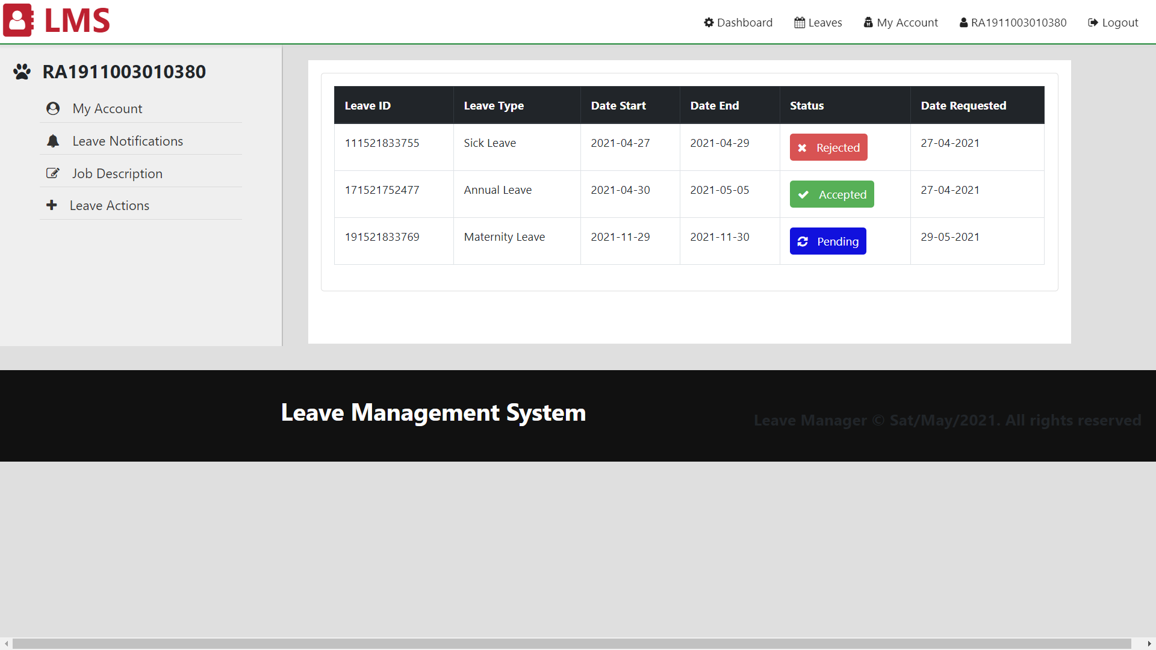
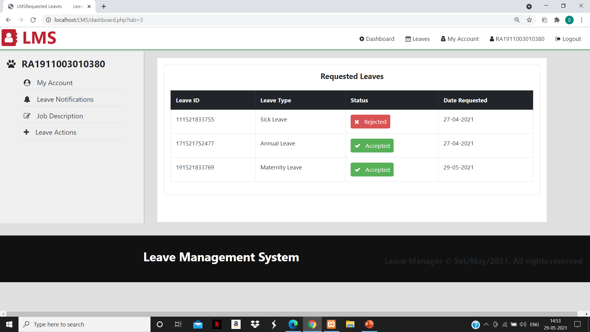
Check if the accepted leave appear in the status

Slide 24
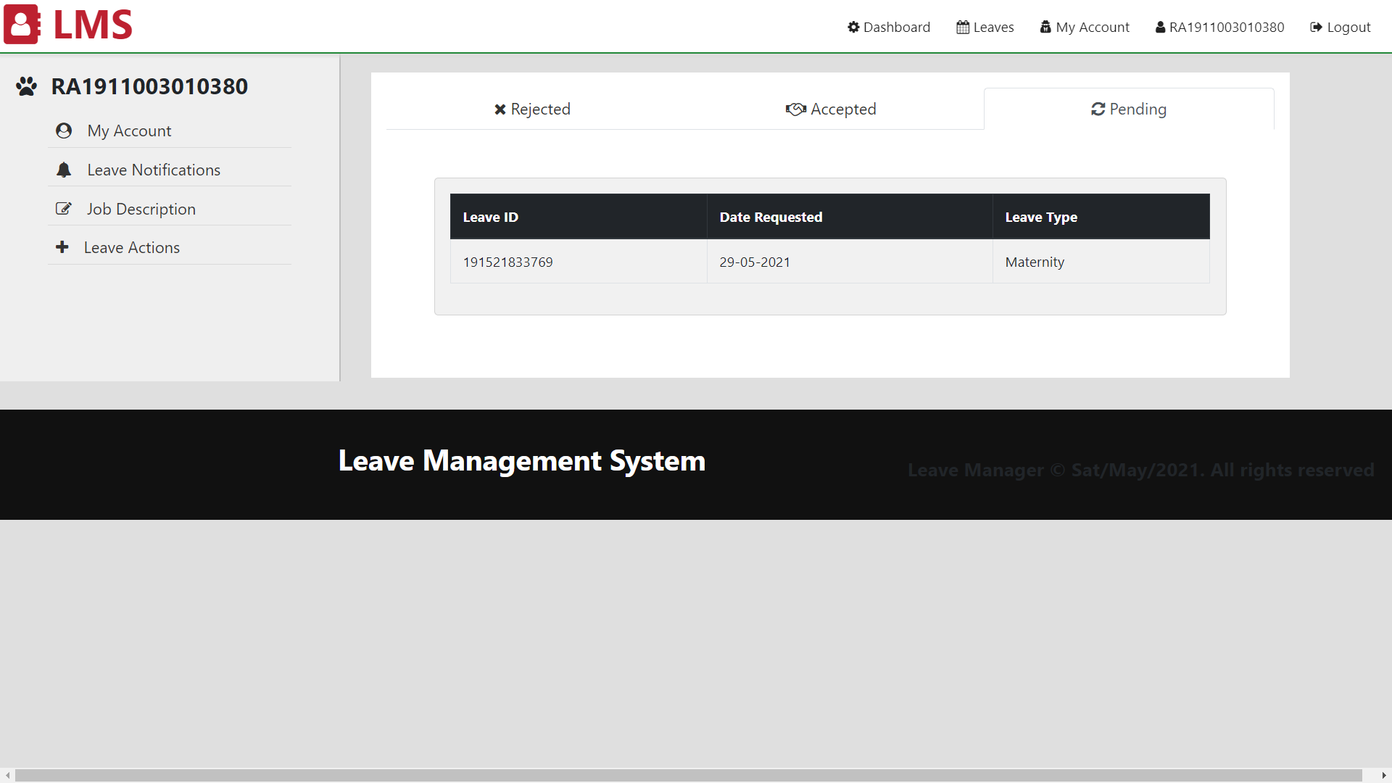
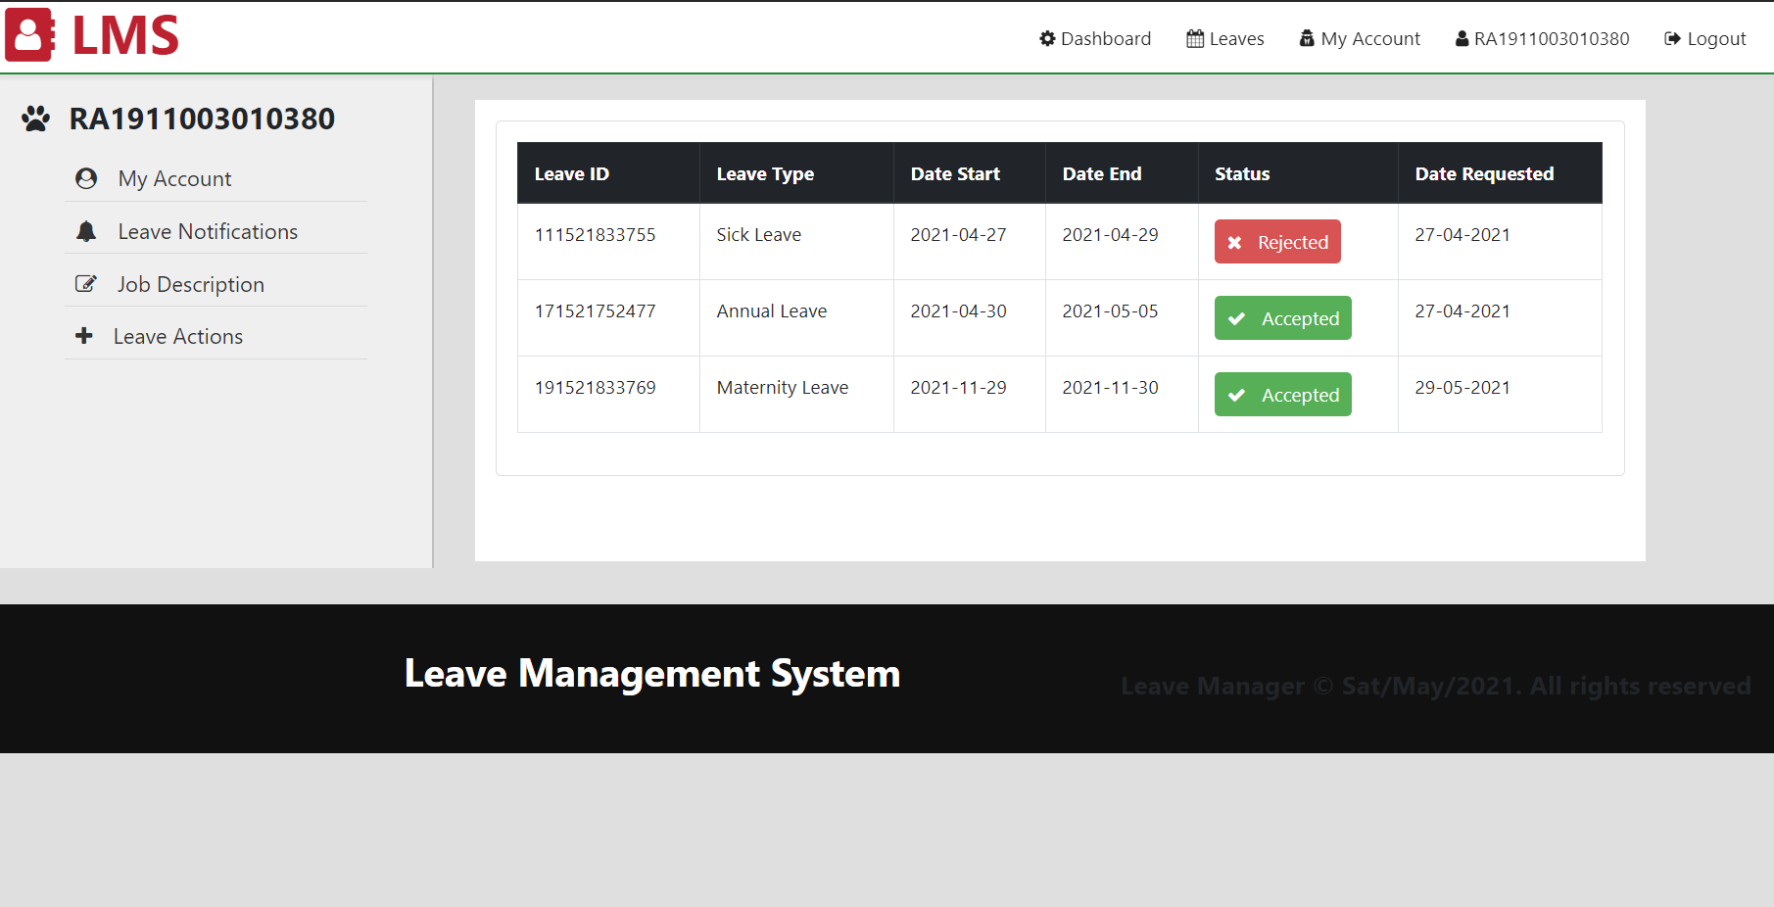
Check if the requested leaves are appearing in the notifications
Check if the report is generating

Slide 25
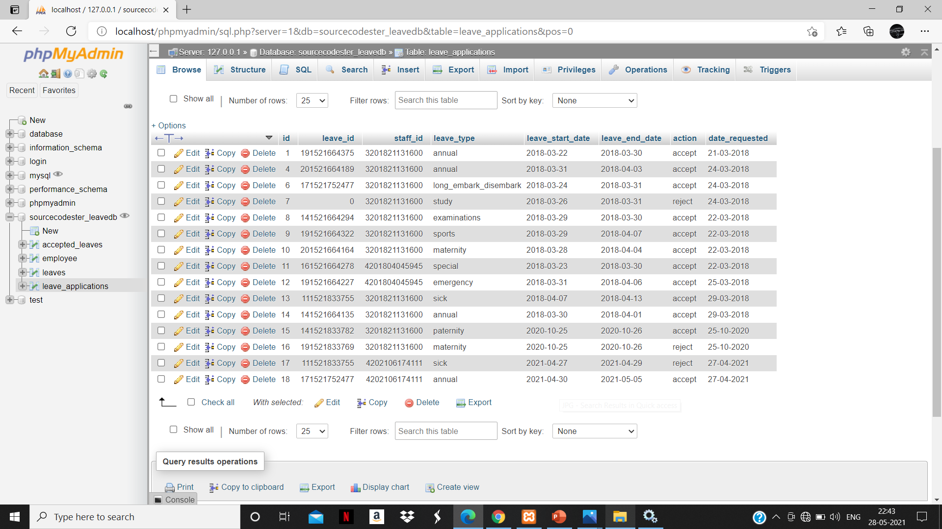
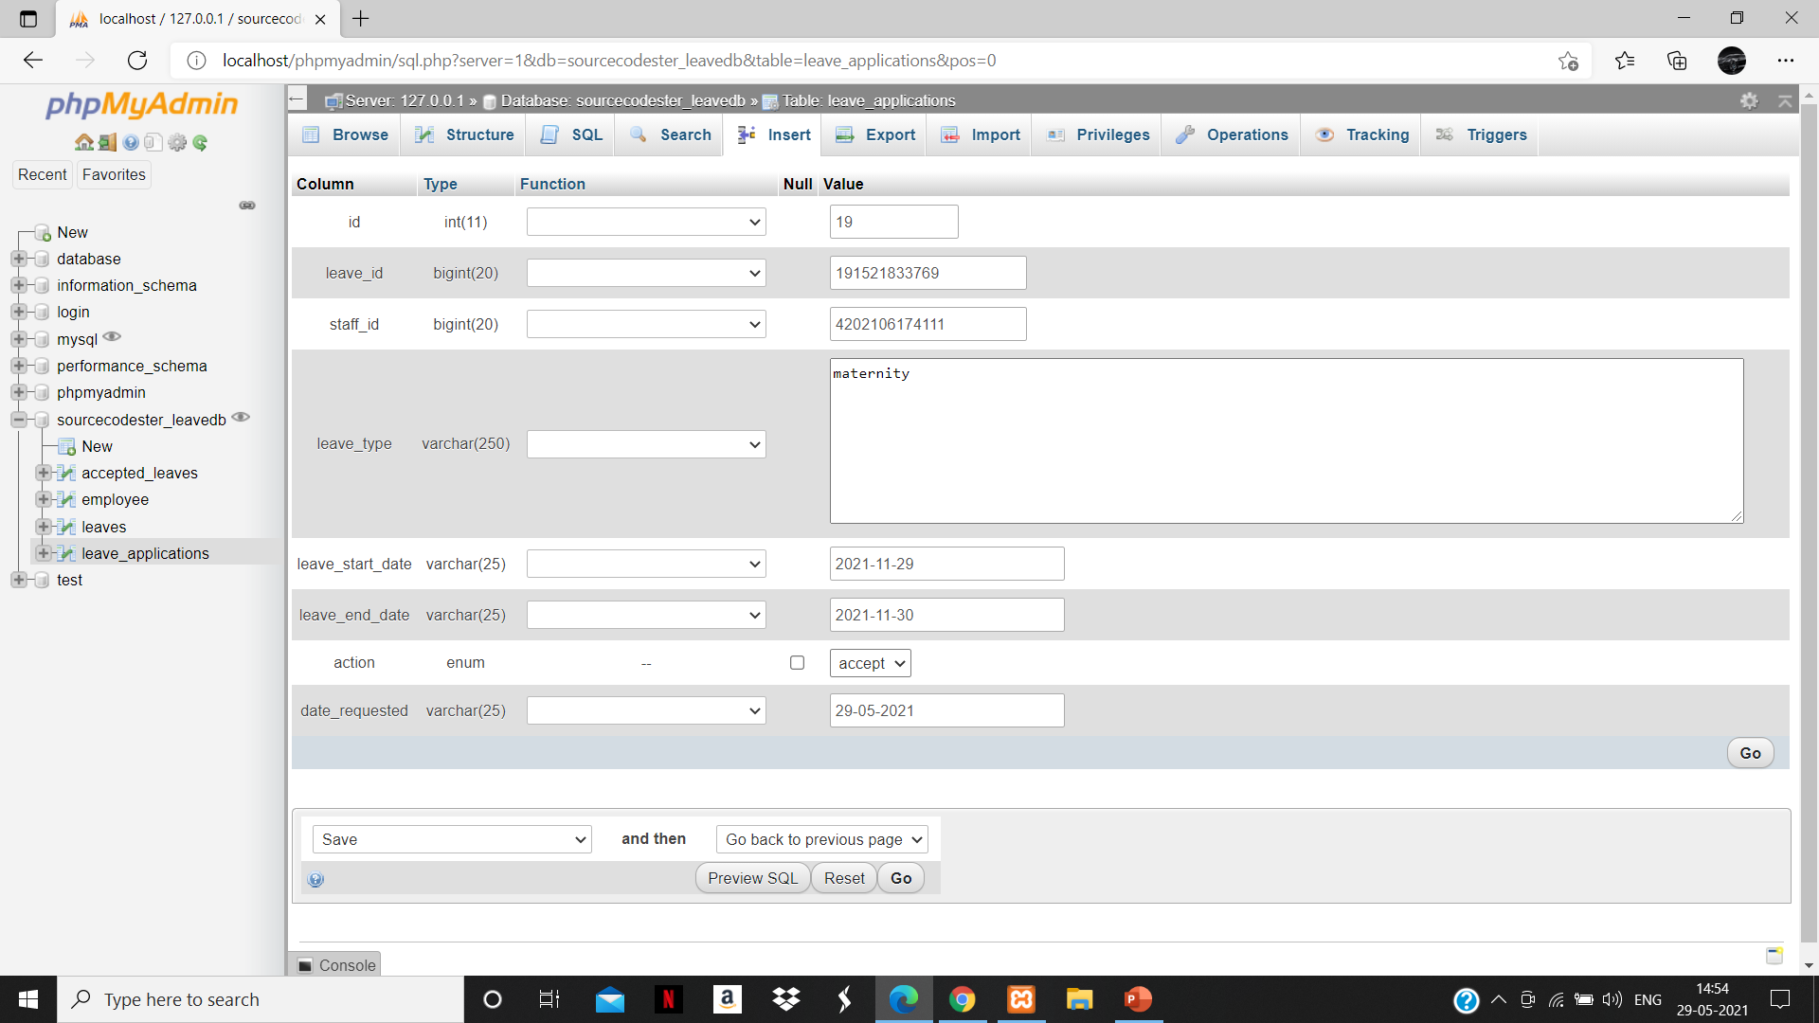
The admin can accept / reject the leave requests
Database stored here

Slide 26
Functional testing
Test ID (#) | Test Scenario | Test Case | Execution Steps | Expected Outcome | Actual Outcome | Status | Remarks
1 | For user registration | The registration interface should open | 1. Click Register button | 1. User should be taken to the next page for entering more user details | It went to the registration interface | Pass | Success
2 | For user login | The login interface should open | 1. Click login button | 1. User should be taken to the login page for entering more user details | Login interface opened | Pass | Success
3 | Verify User Registration | Accept the details in give format Name should be in character E-mail consists of @ symbol Password should be 8 numbers | 1. User clicks on user registration link 2. Enter the enter the details in the text box | 1. User should be taken to the login interface | Registration successful | Pass | Success
4 | Verify User Registration from India | Don’t accept Non-Indian Mobile Number on the Page#1 | 1. User enters number 2. User clicks on submit | 1. Number invalid should appear in dialogue | Dialogue box appears | Pass | Success
5 | Write on text box | Accept the letters on text boxes | 1. User click on text boxes | 1. Dialogue Box should appear to enter the text | Dialogue box opened | Pass | Success
6 | Verify the change password feature | Allow the user to change password whenever they want | 1. User clicks on change password | 1. Dialogue box to change password comes up | Dialogue box opened | Pass | Success
7 | Verify the new registration feature | Allow the user to register using new credentials | 1. User clicks on new registration to make a new account | 1. Dialogue box to make a new account comes up | Dialogue box opened | Pass | Success
8. | Verify that error message is displayed on giving wrong credentials | Allow user to login using right credentials only | 1.. User enters wrong credentials to login | 1. Dialogue box pops up telling user to check credentials | Dialogue box opened | Pass | Success

Slide 27
Non functional testing
Test ID (#) | Test Scenario | Test Case | Execution Steps | Expected Outcome | Actual Outcome | Status | Remarks
1 | Verify number of characters in the password | Accept any number of characters in password | 1. User inputs the password characters | 1. Any number of characters should be accepted | All the characters are successfully accepted | Pass | Success
2 | Verify if the password contains alphabets, numerals and special characters | Accept alpha numerals as well as special characters | 1. User enters the password containing numbers and special characters | 1. All the characters should be accepted | All the characters are successfully accepted | Pass | Success
3 | Verify that there is only one login from a browser at a time | There should be only one login into the application at a time from a browser | 1. User logs into the application using two accounts in the same browser | 1. The login page shows error while logging in from second account | The error message is successfully shown | Pass | Success
4 | Verify that the login works in different browsers | User should be able to login from any browser | 1. User logs into the application from different browsers | 1. Successful login | The login page works in almost all major browsers | Pass | Success
5 | Verify the back button after logging out | The back button should not re-enter the account after logging out | User logs out and presses the back button | Error message should be displayed | The browser shows error on pressing the back button after logging out | Pass | Success
6 | Verify if the password is hidden | Accept the password and make sure the letters are hidden | 1. User enters the password | 1. The password characters should not be visible | Password characters are not visible | Pass | Success
7 | Verify that the login page should take less than 3 seconds to load and it is available 24*7 | Accept login from user any time and take less than 3 seconds to log in | 1. User enters the credentials to log in | 1. User should be allowed to login anytime | 24*7 login is made available with login taking less than 3 seconds | Pass | Success

Slide 28

THANK YOU
#STAY SAFE

